Slide 1



GRA-UML
Status & Demo
September 2014

Slide 2
Agenda
Review of GRA-UML [Cory]
Review sample model based on “SIRS” [Cory]
Demonstrate tool chain [Tom]
UML tool to XMI
Launch of provisioning from eclipse (includes both phases)
Review phase-1 artifacts [Tom]
Review phase-2 artifacts [Todd]
Specification overview [Steve]
Optional: Detail on topics where requested
Conclusion and questions*
* We will stop for questions after each section

Slide 3
GRA-UML Status
OMG Process
RFP was issued September 2013
Initial submission provided to OMG August 18th, 2014
OMG Document: gov/14-08-01 and on GIT site
Details and machine readable artifacts available on GIT site
https://github.com/GRA-UML/specification/
Fully OMG conformant artifacts will be provided as part of the final submission. Currently Eclipse and Magicdraw artifacts are available
Briefed to OMG government task force 9/15
Final submission due: November 10th, 2014.
Open source implementation is proceeding well, demo to follow
Participation and comments welcome.
Mail list: gra-uml@modeldriven.org

Slide 4
Goals
Provisioning¹ a complete and conformant GRA service specification (SSP)
Providing flexibility for the many possible variations in service technologies, standards and styles
Allowing use of “normal” UML wherever possible
Allow use of SoaML patterns without requiring SoaML stereotypes.
Deliver with an open source implementation
1: Provisioning is the process of creating derivative artifacts from a model using Model Driven Architecture (MDA)

Slide 5
Significant Design Choices

Slide 6
Use of UML Instance Specifications
Choice
GRA specific properties are defined as classes in the specification. The architect then creates UML instance specifications. We call these “annotations”.
Most profiles have utilized stereotypes and tag values more extensively.
The UML annotation class model is considered part of the profile
Reasons
GRA metadata is quite extensive, UML classes provide a more powerful modeling paradigm than tags
GRA metadata is data, which is the intent of instance specifications
UML descriptions can be used, which are more suited to documentation sections than tag values
GRA is one potential target of a service model – the instance model realizing normal UML constructs better separates concerns.
No conflict with or dependence on SoaML or any other services profile (such as DoDAF).

Slide 7
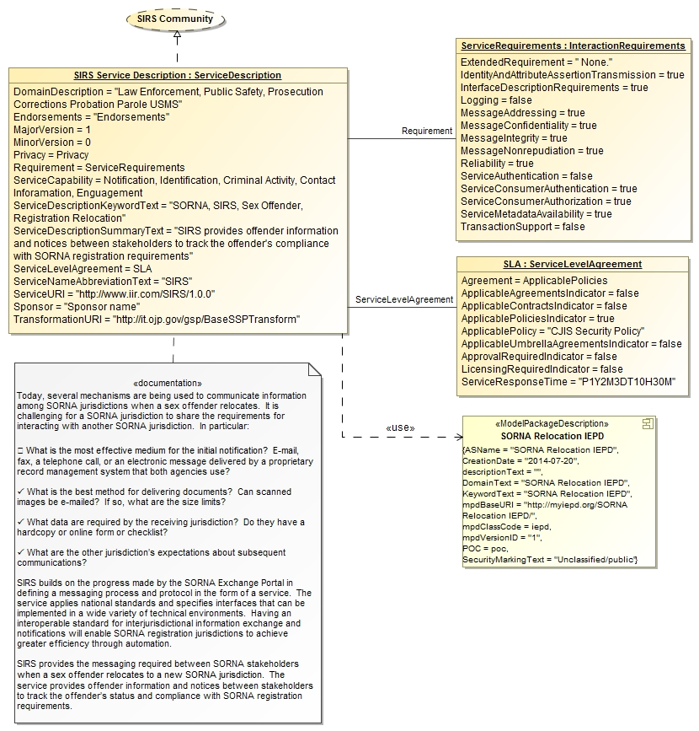
Example Instance Model
Instance element realizes UML PIM element
SSP uses one or more NIEM IEPDs

Slide 8
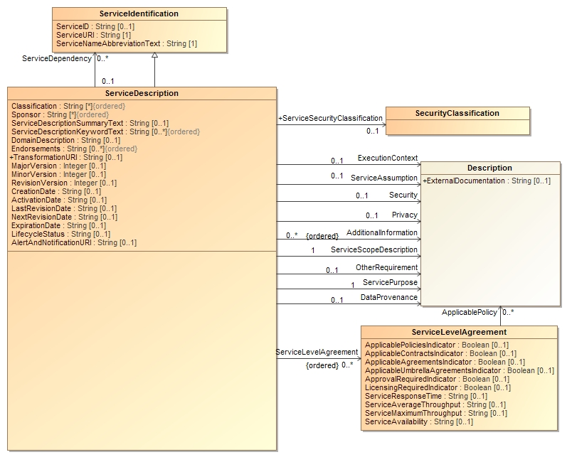
Example annotation model fragment

Slide 9
The critical role of realizations
GRA instance specifications typically realize a UML PIM element. This defines how that UML element will be interpreted in GRA.
All sub elements of the PIM component that have meaning in GRA-UML will also generate default instance specifications.
Instances realizing UML elements is the way the UML model is “interpreted” as GRA specification. This controls what is generated.

Slide 10
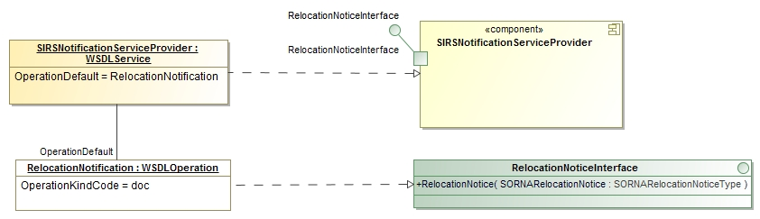
Realization example
1
2
1: The SIRSNotificationServiceProvider WSDL Service instance specification realizes the component by the same name.
2: The RelocationNotification WSDLOperation instance specification realizes the RelocationNoticeInterface

Slide 11
Two phase provisioning
Choice
The provisioning from a model to a final SSP is divided into two phases. An “intermediate form” in OMG-XMI is the connection between the two phases. This is to enable the expected variation in the form of a final SSP
The first phase uses OMG technologies (MOF & QVT) and is fixed by the GRA-UML specification.
The second phase uses developer focused technologies (XSLT & Ant) and is intended to be changed or augmented by developers with specific technology or stylistic choices.
The second phase is controlled by a reusable “template” (collection of XSLT supporting artifacts). The supplied default template is non-normative but produces a functional and conformant SSP.
Reasons
GRA provides guidance on technology choices and how they are to be used, but SSP developers typically make substantial technology and stylistic design choices – there is no one “right” SSP for a given PIM.
The typical SSP developer would not be comfortable modifying or implementing QVT or MOF meta models. These technologies are best implemented by UML tool developers.
XSLT and Ant are available on all mainstream platforms. These are technologies developers are used to dealing with. However, XSLT lacks the expressiveness required to process complex UML models as required in phase one.

Slide 12
Two Phase Provisioning
Allow variation here
Focus: Service Architects & GRA-UML Tool Builders
Focus: GRA Specification Architects & Developers
Uses OMG Technologies (e.g. MOF & QVT)
Uses Developer focused Technologies (e.g. XSLT & Ant)

Slide 13
Notional Workflow
Data architect creates exchange content using NIEM-UML (note that existing IEPDs can be imported)
Services architect creates UML model for the required services as UML interfaces and components, using the NIEM data types
GRA Services architect annotates services model with GRA metadata using UML instances
Provisioning tool is evoked
NIEM-UML provisioning creates IEPD
GRA-UML provisioning creates basic GRA SSP structure with “annotation.xml”, a simplified OMG-XMI file to power “phase 2” as input to XSLT
Based on a metadata property, a phase-2 “ant” build script takes over. This script may utilize other transforms and artifacts. The specification comes with a non-normative default phase-2 build and artifact template.
XSLT is used to create final SSP artifacts.

Slide 14
Implementation Components
Any UML modeling tool
Must be able to utilize profile
Must be able to save to Eclipse-UML format
At this time no UI specialization seems needed
Magicdraw (commercial) has been used as it is a better tool
Will also be validated with Papyrus (Open source UML) – may need customization for constrants
Phase-1 provisioning – open source
Implemented as an eclipse plugin
Generates base artifacts from model, including “annotations.xml” intermediate form
Phase-2 provisioning – open source
Default template provided, may be modified by developers
Implemented using XSLT and ANT
Generates final SSP based on phase-1 artifacts
Called from phase-1 eclipse build

Slide 15
The UML PIM

Slide 16
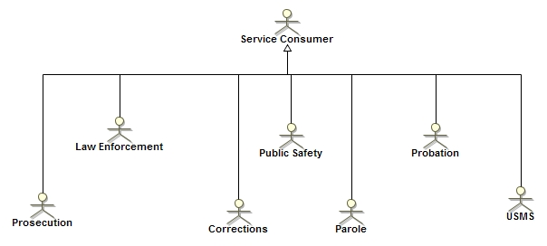
Actors

Slide 17
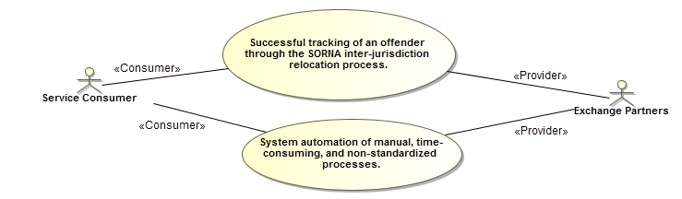
Use cases
GRA: Real World Effect

Slide 18
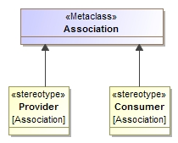
The GRA Profile Stereotypes
Used to distinguish provider Vs. consumer in a business use case

Slide 19
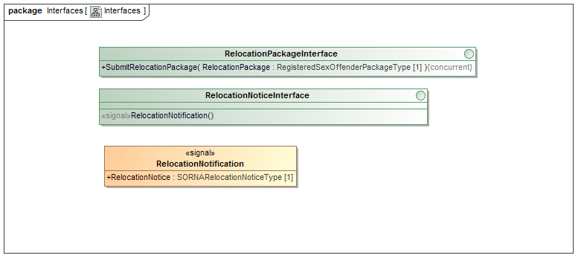
Interfaces
Become WSDL port types and “Actions”

Slide 20
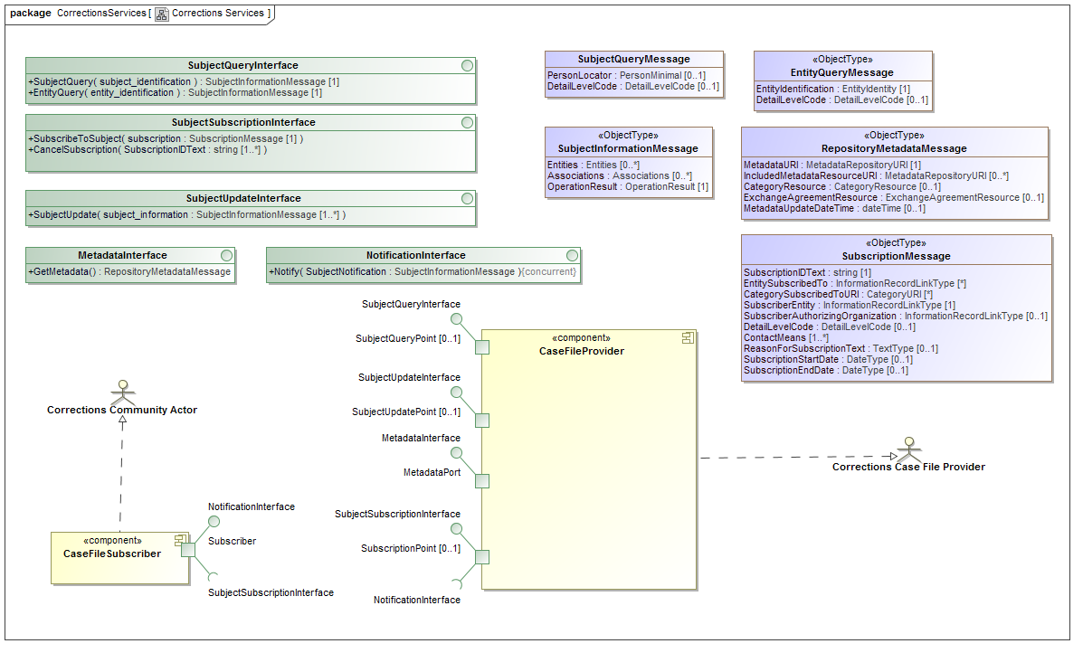
Ports on Components
Each component is a service, ports relate to WSDL ports

Slide 21

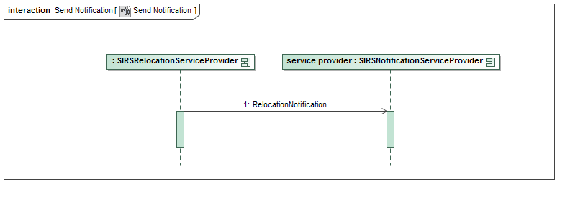
Communities and Interactions
Become GRA Exchange Choreographies

Slide 22
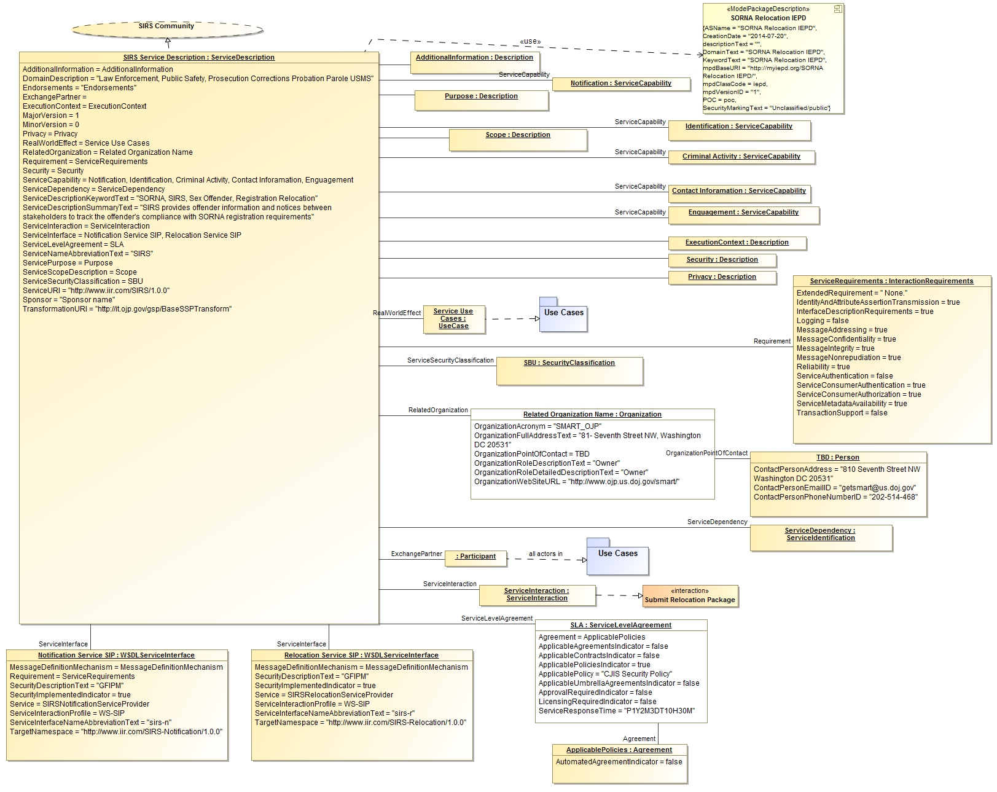
GRA SSP Specific Metadata
Populates output from “phase 1”

Slide 23
Expansion of metadata

Slide 24
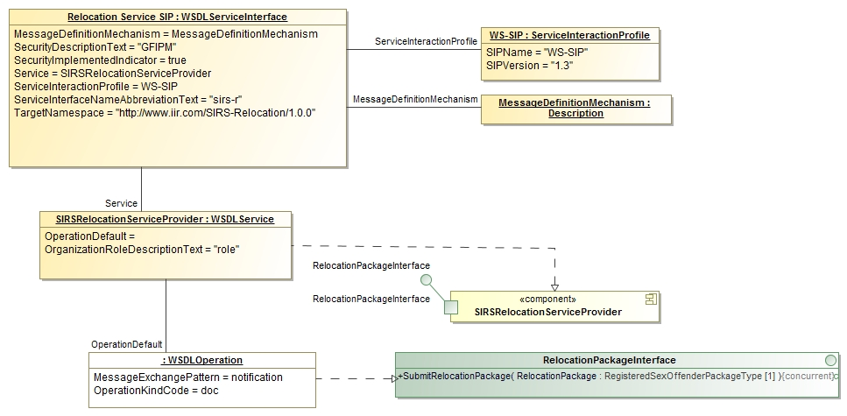
Exammple SIDD (Service Interface) Metadata

Slide 25
Phases Summary
Metadata plus PIM information is output to a skeleton SSP with “annotation.xml” reflecting the UML instances.
XSLT and Ant is then used to process these files to produce final SSP.
Developers will be able to “tune” phase 2 for use of other styles and technologies. It is expected there will be a selection of reusable phase-2 templates.

Slide 26
Intermediate Form
The PIM and annotations control the provisioning process
Part of what is provisioned is “annotations.xml”, essentially the “abstract syntax” for an SSP. Abstract syntax means it is the information without any presentation or technology form.
The annotation.xml meta model is very similar to the annotation UML classes, in fact they both derive from the same base model.
UML Instances plus the PIM components populate annotations.xml

Slide 27
Metadata Model

Slide 28
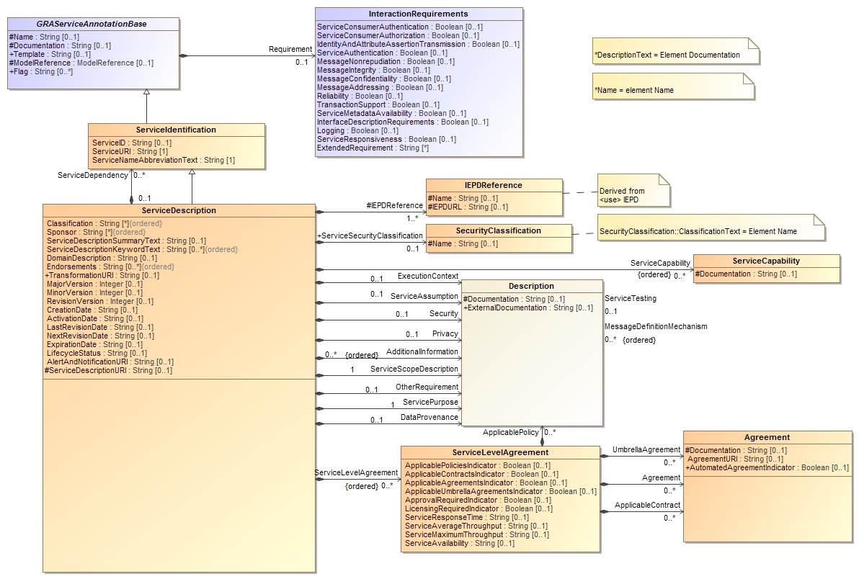
SSP Annotation & Metamodel

Slide 29
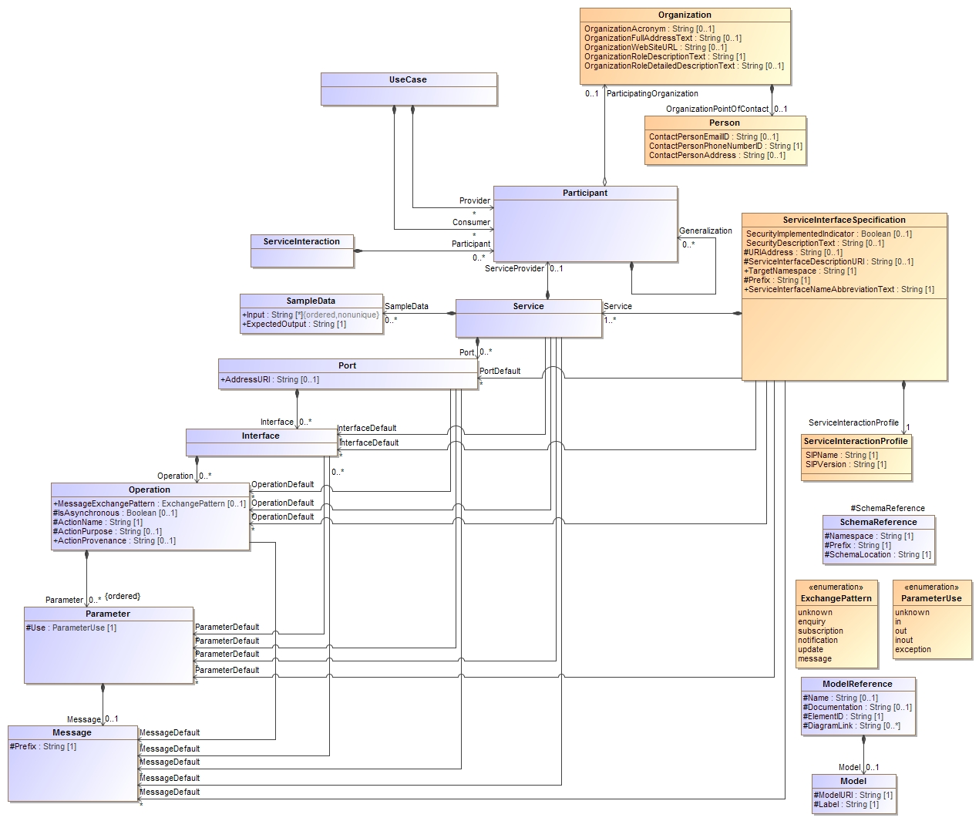
Service Interface Specification Model

Slide 30
Use of “defaults”
Most annotation parameters are set by default based on the realized PIM element.
Explicit defaults allow the specification of parameters of an element within a service interface without having to model the entire structure.
Note “default”

Slide 31
Example default
Anywhere within SIRSRelocationServiceProvider where the “RelocationPackageInterface” is used, set the MessageExchangePattern to “notofication” and the OperationKindCode to “doc”
Default

Slide 32
What is produced
Result of phase-2

Slide 33
Primary artifacts
GRA artifacts have specific formats and content
SSP Document
For each service specification
WSDL (default template produces web services)
Service interface specification document
UML Models
NIEM IEPD

Slide 34
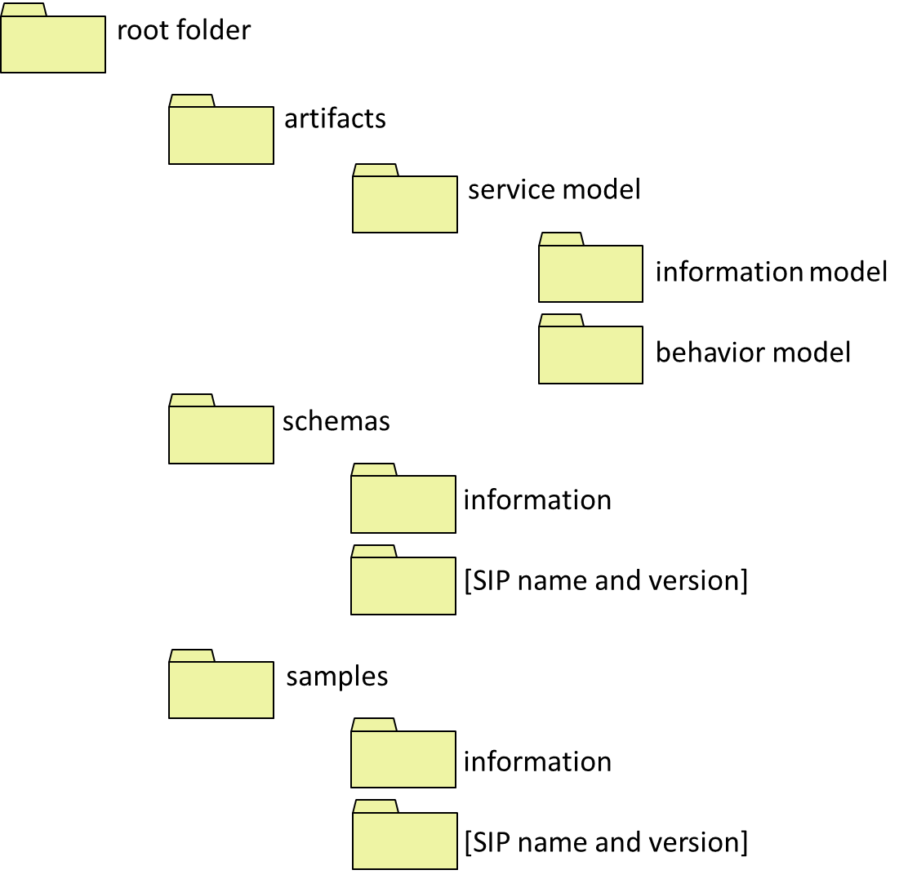
Folder structure for a GRA SSP

Slide 35
Still do to
Complete validation of the entire process
OMG conformant artifacts
Complete open source implementation
Document QVT
Complete default template
Open question: Samples

Slide 36
Questions and comments…

